Slide 1

Appointment Scheduling System for HealthyLife Clinic
Team 2B
Presented by: Yash, Lucky, Douglas, and Arafat
Instructor: Maria Garrity
Date: May 6th, 2025

Slide 2
Team Roles
• Yash – Project Manager, UI/UX Designer, Quality Assurance, Interviewer • Lucky – Business Analyst, Planning & Documentation • Douglas – Backend Developer, System Setup • Arafat – Helped with PowerPoint & team coordination

Slide 3
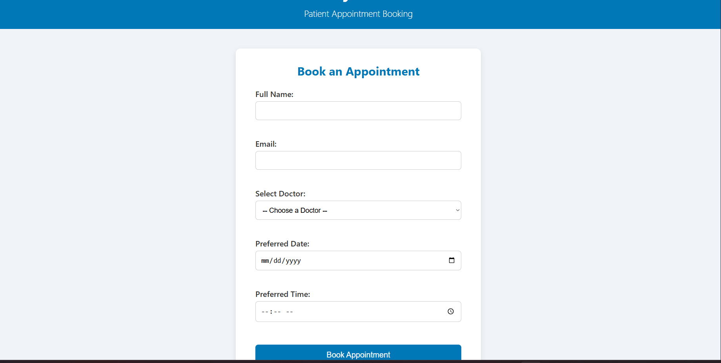
Problem Statement
The current appointment system at HealthyLife Clinic is manual and paper-based, leading to major issues:
Patients often get double-booked due to overlapping paper entries
Long wait times and missed appointments are common
Staff face an increased workload, constantly managing paper logs
There are no reminders, so patients frequently forget their slots
These issues reduce both efficiency and patient satisfaction. A web-based appointment system is needed to solve these problems and modernize the clinic’s workflow.

Slide 4
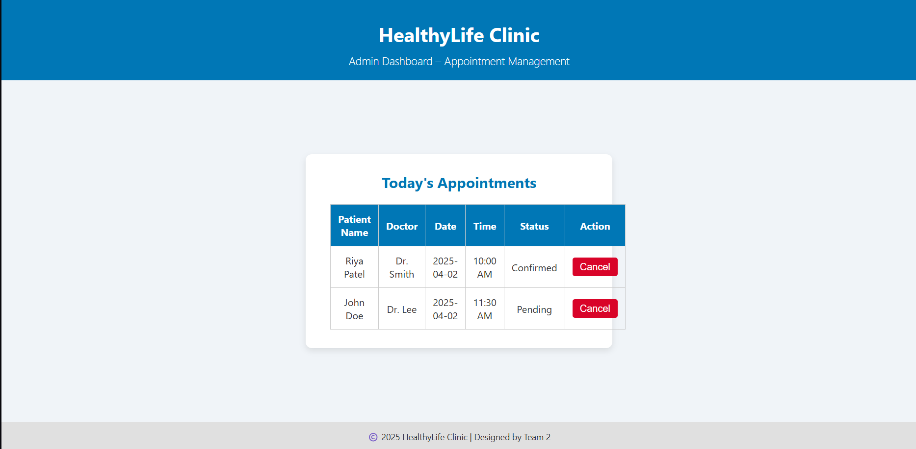
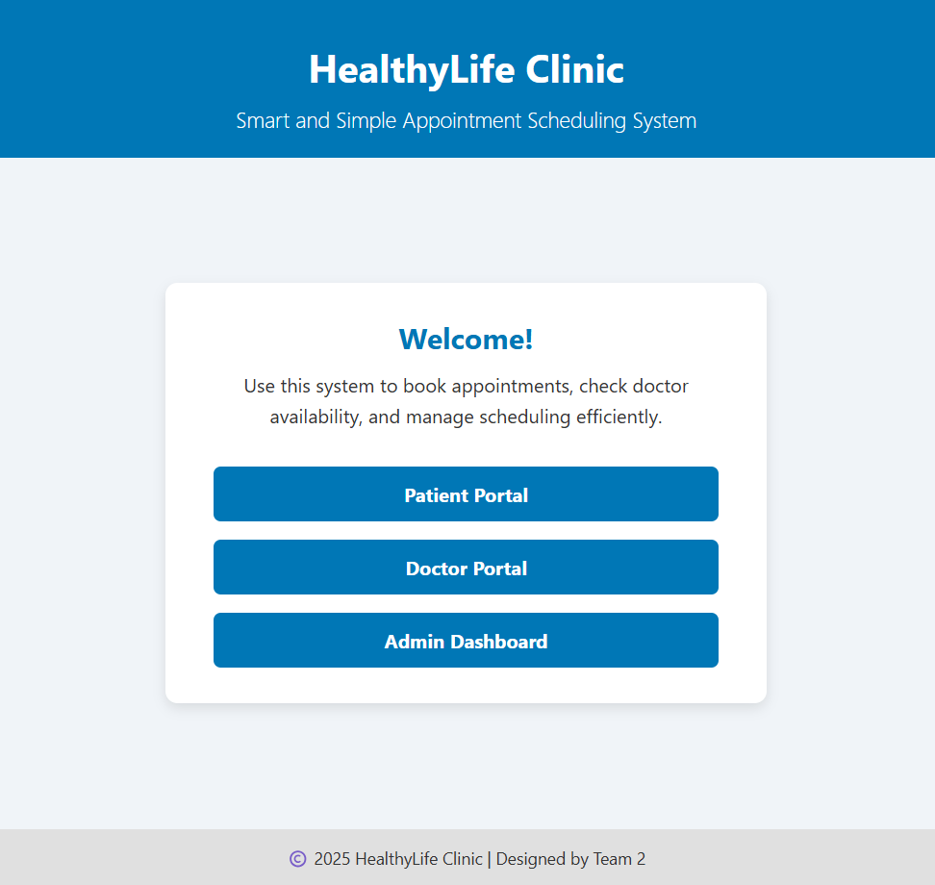
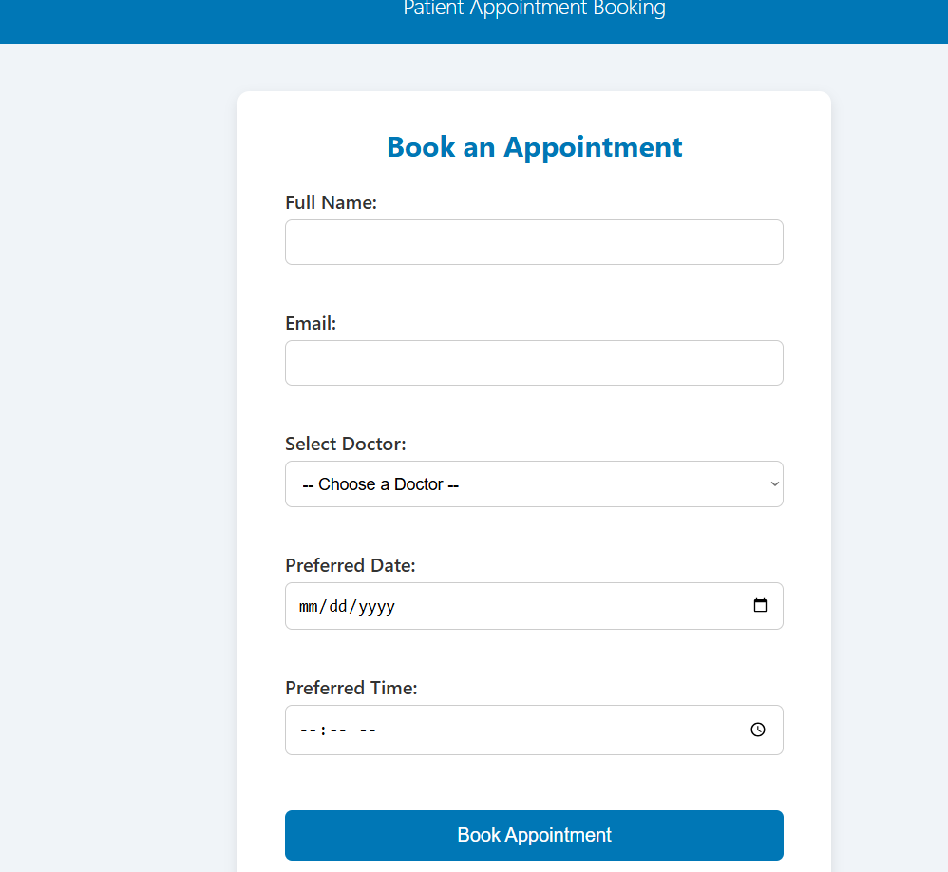
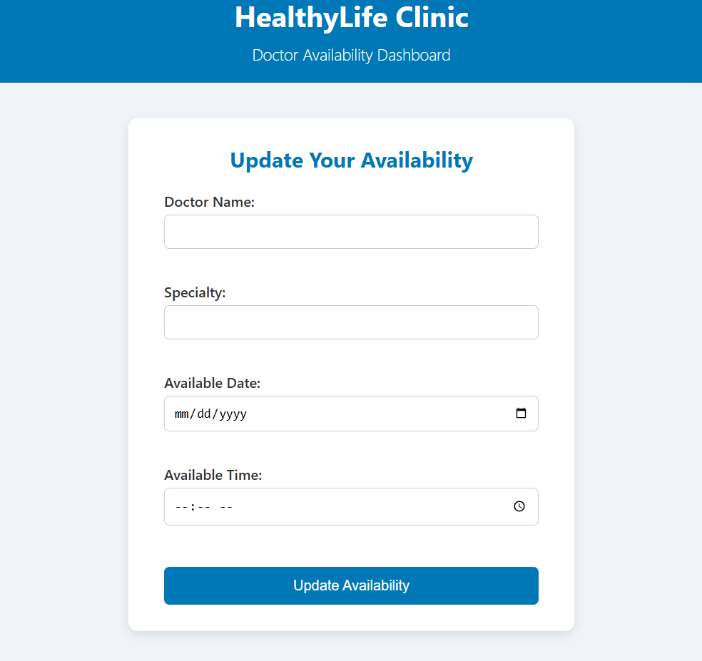
Project Objectives
The main goal is to make a system where:
Patients can book or cancel appointments online
Doctors can update their available time slots
Reminders go to patients by email or SMS
Admin can manage everything in one place
Also, the system works on both mobile and desktop.

Slide 5
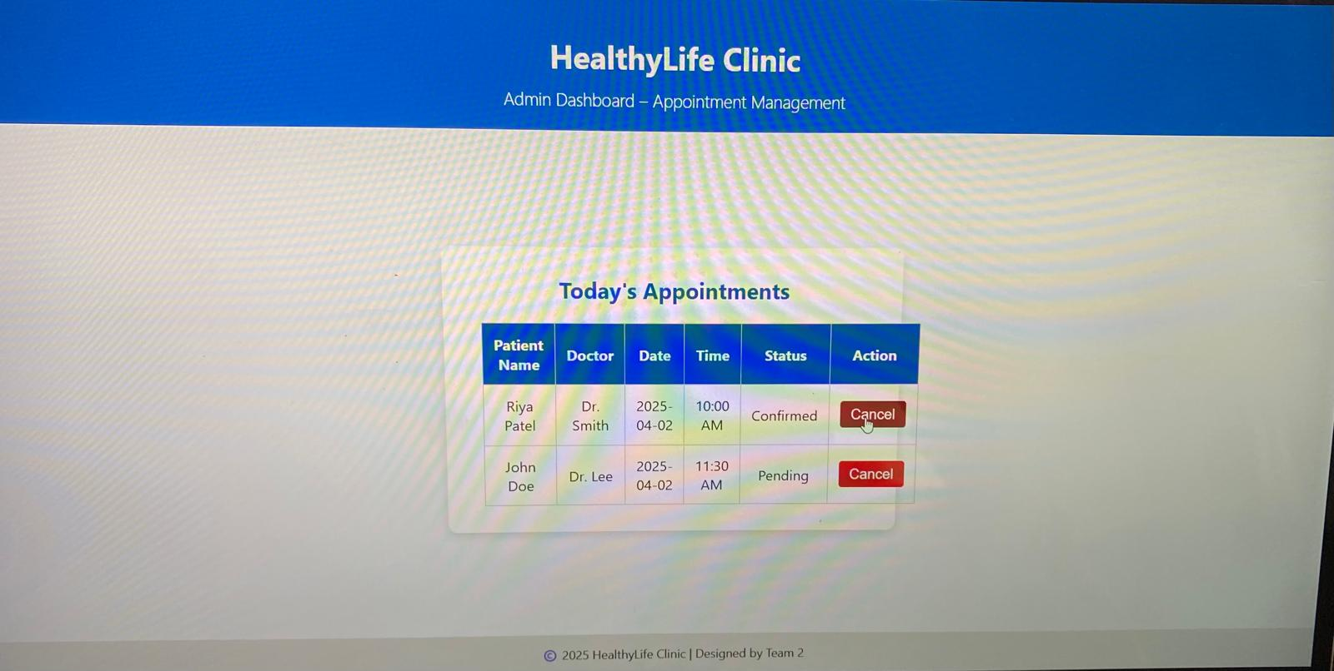
Functional Requirements
• Patients can book, cancel, or reschedule appointments • Doctors can update their availability • Admins manage all users and appointments • Automatic email/SMS reminders • No double-booking — system checks availability • Fully mobile-friendly design

Slide 6

User Interface Mockups
• Homepage with login options for patients, doctors, and admin • Patient booking form (simple and mobile-friendly) • Doctor availability form • Admin dashboard with appointment control
All pages are built using HTML, CSS, and JavaScript. Each user has a separate interface for ease of use.

Slide 7
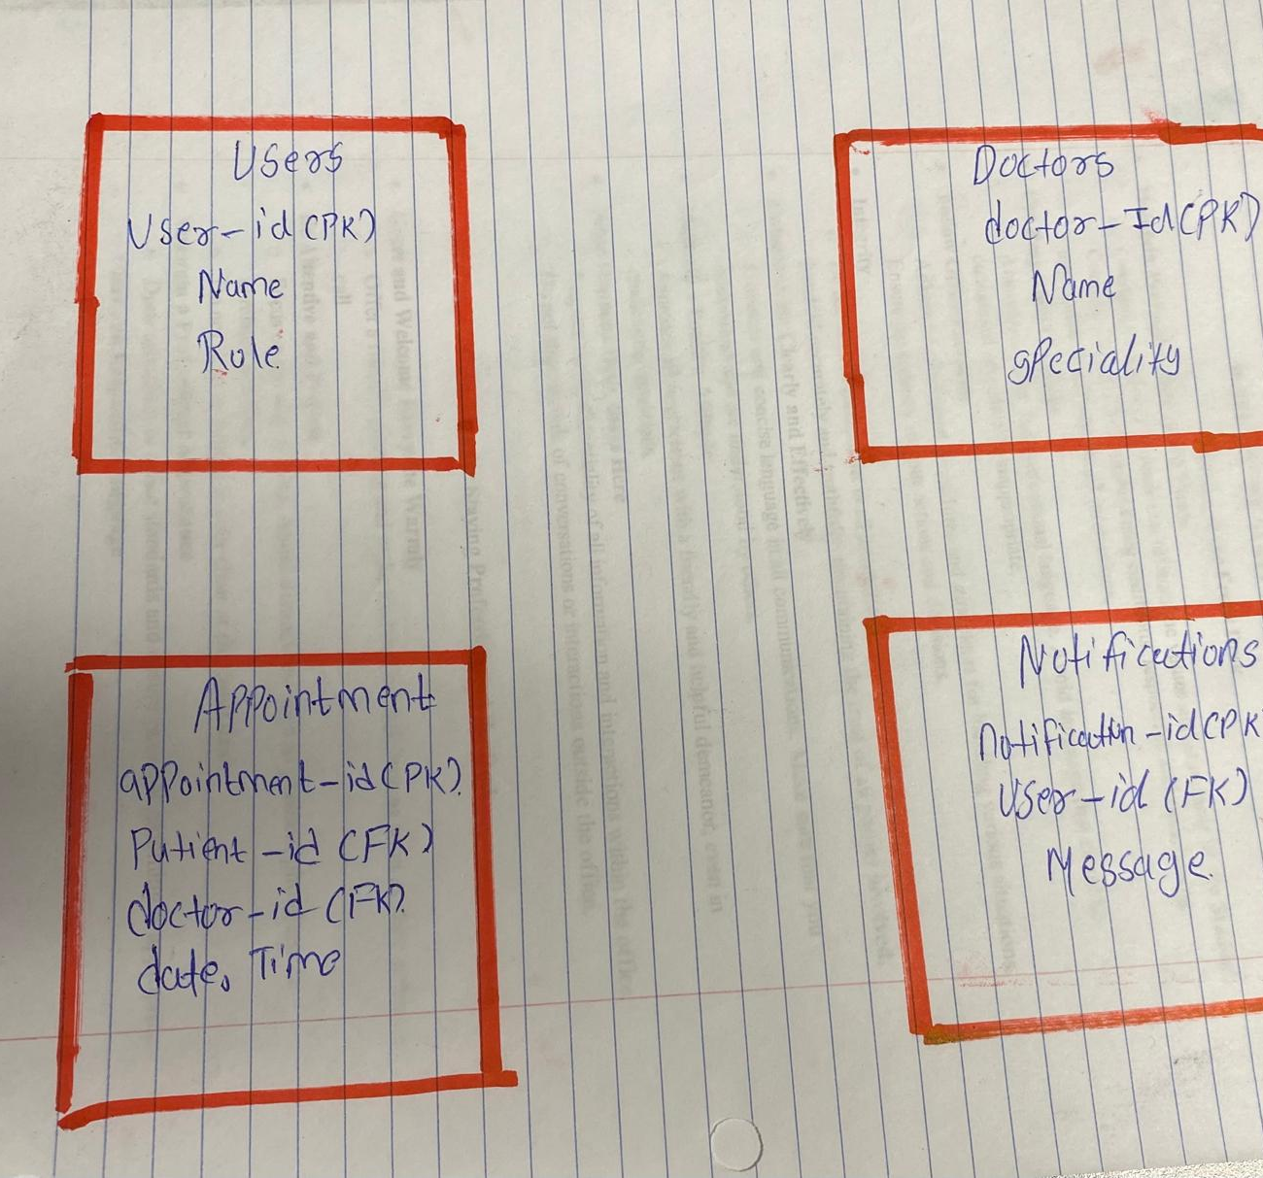
Database Schema - ER Diagram
Database Schema Overview
Users – Stores login info and roles (patient, doctor, admin) Doctors – Stores doctor details like name, specialty, and availability Appointments – Tracks patient, doctor, date, time, and appointment status Notifications – Logs reminders or confirmations (via email/SMS)
Relationships are established with foreign keys linking the tables

Slide 8
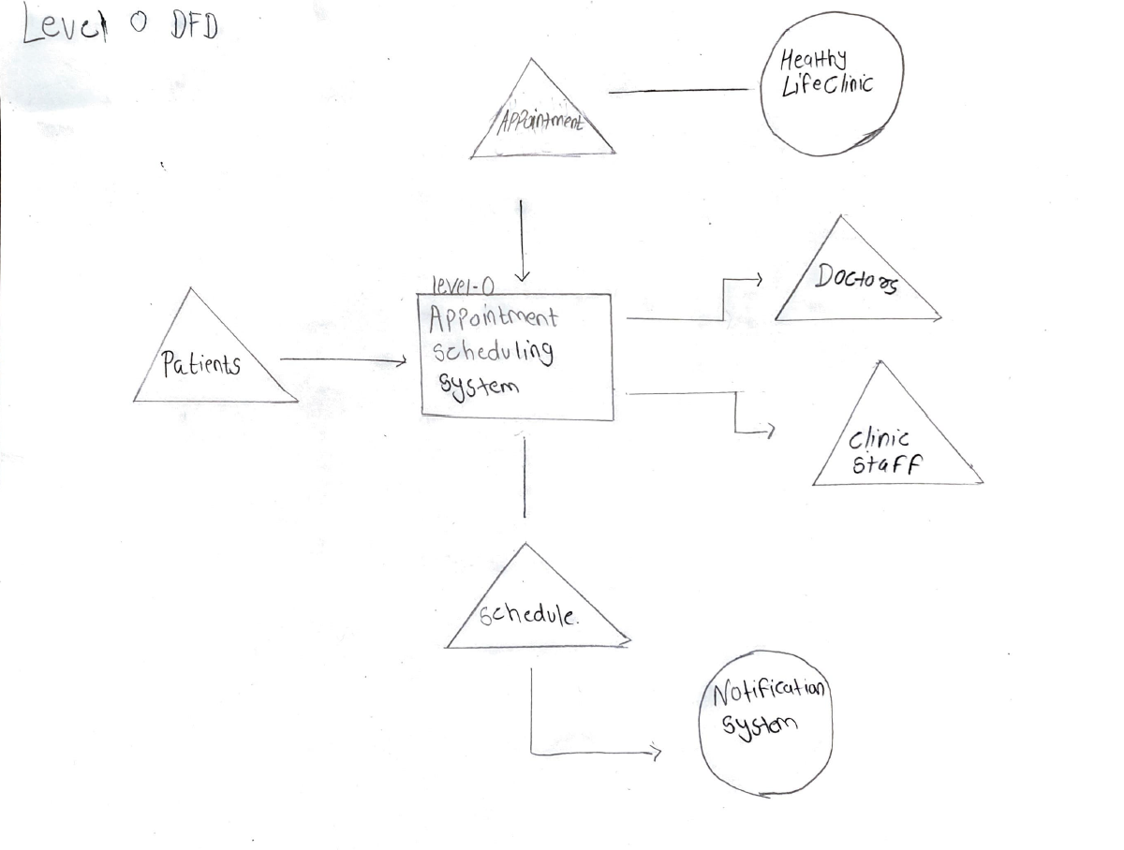
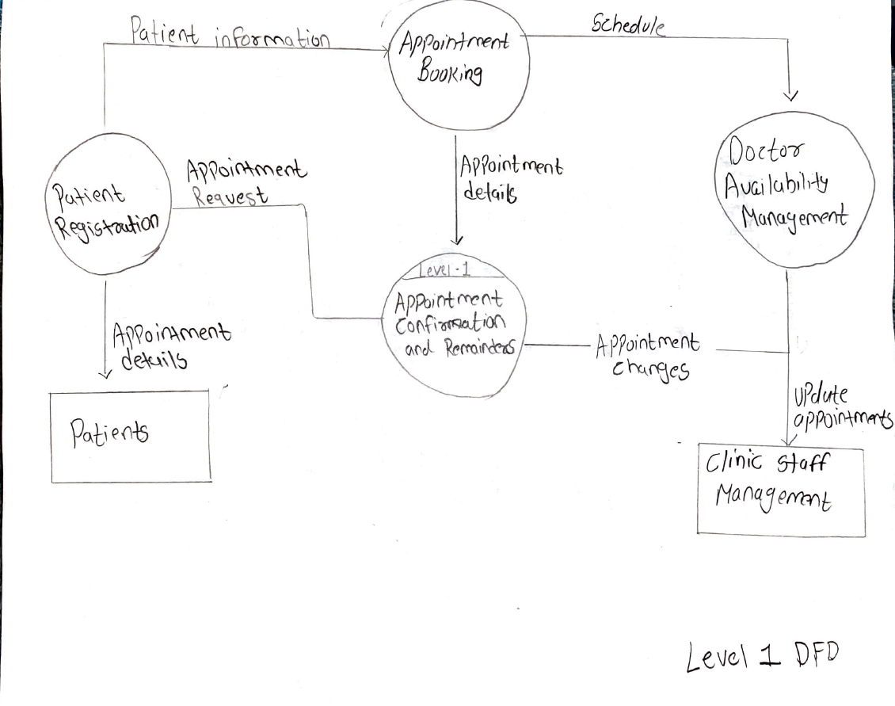
Data Flow Diagram (DFD)
The DFD shows the flow of data through the HealthyLife Clinic Appointment Scheduling System:
Patient provides login details and selects appointment preferences.
Two doctors have available appointment times. Admin manages appointments and sends confirmation reminders.
System stores appointment details and sends automatic notifications to patients.
The diagram includes external entities like Users (Patient/Doctor), System, and Admin

Slide 9
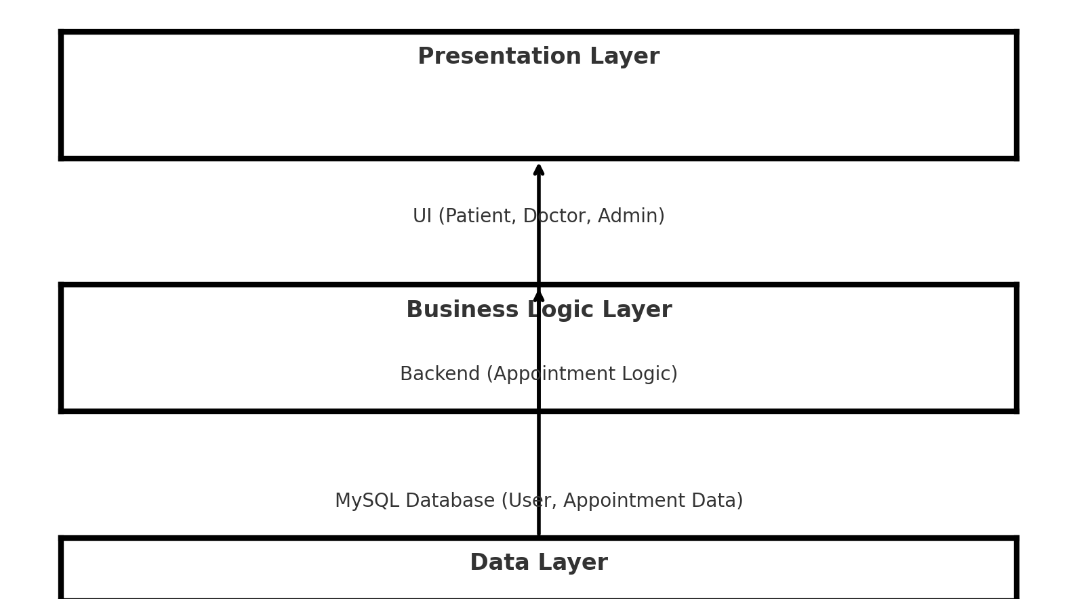
System Architecture
The architecture of the HealthyLife Clinic Appointment Scheduling System is based on a three-tier architecture:
Presentation Layer (Frontend):
Built with HTML, CSS, and JavaScript
Handles user interfaces for patients, doctors, and admins
Business Logic Layer (Backend):
Handles business rules like appointment scheduling, availability checking
Developed using PHP/Python
Data Layer (Database):
Stores user data, appointments, and notifications
Use MySQL for data storage and retrieval
This architecture ensures scalability, security, and efficient data handling.

Slide 10
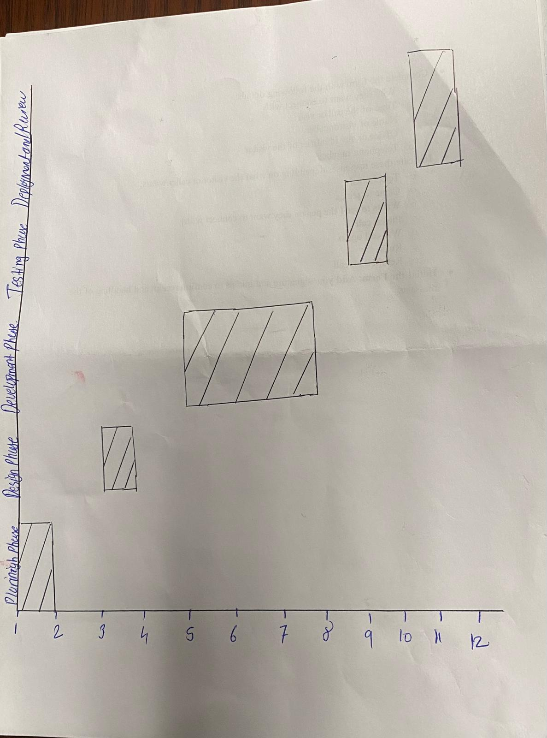
Project Timeline
The development of the HealthyLife Clinic Appointment Scheduling System follows a structured timeline:
Planning Phase (Week 1–2)
Finalize system requirements and goals
Initial team meetings and project assignment
Design Phase (Week 3–4)
UI mockups and system architecture design
Define database schema
Development Phase (Week 5–8)
Frontend and backend development
Integration of database and appointment system
Testing Phase (Week 9–10)
Manual and automated testing
Bug fixes and system optimization
Deployment & Review (Week 11–12)
Final deployment of the system
Review and presentation preparation

Slide 11

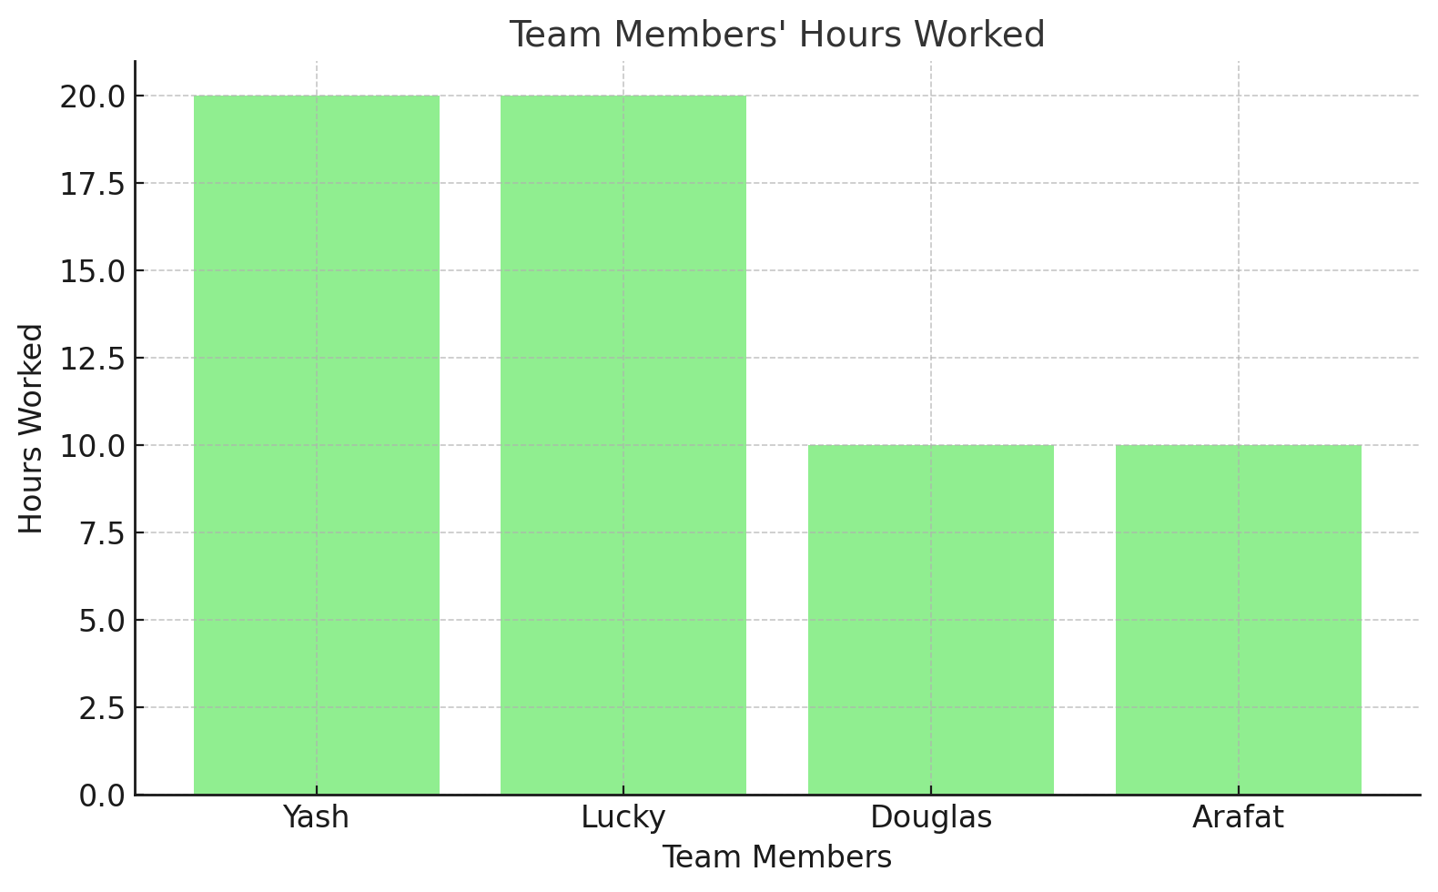
TeamWork Log
TeamWork Log – March to April 2025
Yash: Led and completed the entire project. Designed the frontend UI, built all mockups, wrote the full business proposal, created the training plan, handled the backend form planning, and managed communications with Dr. Garrity. All documents, diagrams, and system elements were created and organized by Yash, Lucky. Rough Hours Per Person:
Yash: 20+ hours (Project Manager – UI, docs, backend, training, communication)
Lucky: 20+ hours (Initial planning, documentation, and feature breakdown)
Douglas: 10+ hours (Presenter, minimal backend discussion)
Arafat: 10+ hours (Helping with PowerPoint)
Date | Members | Hours | What We Worked On / Notes
Mar 20 | Whole Team | 2 hrs. | First sit down to discuss project ideas and review the professor's expectations.
Mar 22 | Yash, Lucky | 3.5 hrs. | Started drafting the scope and issues faced by the clinic based on the manual system.
Mar 24 | Yash, Lucky | 1.5 hrs | Looked at similar scheduling systems, started writing the 'solution' section.
Mar 26 | Whole Team | 2.5 hrs | Agreed on roles, went over timeline. Lucky took most notes.
Mar 28 | Yash, Lucky | 1.5 hrs | Did the interview with the front desk staff. Arafat led questions. Yash wrote down key points.
Mar 30 | Yash, Lucky | 2 hrs | Planned the database tables. Yash helped create a schema, and Douglas supported field types.
Mar 31 | Yash, Lucky | 2 hrs. | Worked on the cost sheet and business justification. Lucky helped break down phases.
Apr 1 | Yash, Lucky | 3 hrs. | Created a training plan and final Q&A for the business case. Printed guides started.
Apr 3 | Yash | 2.5 hrs. | Made HTML mockups for patient and doctor pages. Yash handled the layout with form behavior.
Apr 4 | Yash | 2 hrs | Final touches on UI (buttons, fonts, responsive layout). Used real feedback from clinic notes.
Apr 6 | Yash, Lucky, Douglas | 1.5 hrs. | Reviewed updates from Dr. Garrity and matched with our features list.
Apr 8 | Yash, Lucky | 2 hrs | Hooked up form submission to dummy backend. Lucky ran logic, and Yash tested the output.
Apr 10 | Yash, Lucky, Douglas | 3 hr | Finished training plan. Sent rollout email to Dr. Garrity. Lucky reviewed it before sending.

Slide 12

Challenges & Solutions
The development of the HealthyLife Clinic Appointment Scheduling System involved overcoming several challenges:
Database Design Complexity
Challenge: Ensuring data consistency and managing relationships between users, doctors, and appointments was complex.
Solution: Created an ER diagram and ensured foreign key constraints to link data consistently.
UI/UX Design for Multiple Users
Challenge: Designing an intuitive and user-friendly interface for patients, doctors, and admins was tricky.
Solution: Iterated on the UI design with feedback from clinic staff, ensuring ease of use for all users.
Backend Logic and Form Integration
Challenge: Hooking up the frontend forms to a backend that processes appointments and availability was difficult.
Solution: Used a dummy backend initially, then tested real-time form submissions with static data.
Team Coordination
Challenge: Managing remote teamwork and coordinating between members.
Solution: Scheduled regular team meetings and tracked progress in a shared document for real-time collaboration.

Slide 13

Future Enhancement As the system continues to evolve, several enhancements could improve the functionality and user experience of the HealthyLife Clinic Appointment Scheduling System:
1. Mobile Version
Enhancement: Develop a mobile version of the system for patients, doctors, and admins.
2. Real-Time Appointment Notifications
Enhancement: Integrate real-time notifications for appointments (via SMS or push notifications).
3. Integrated Payment Gateway
Enhancement: Add a payment system to handle appointment payments directly through the platform.
4. Advanced Reporting for Admins
Enhancement: Implement advanced analytics and reports for admin users to track appointment trends, no-shows, and doctor availability.
5.AI-Powered Doctor Matching
Enhancement: Introduce AI-powered recommendations for patients to match with the most suitable doctor based on their needs.

Slide 14
Project Conclusion The HealthyLife Clinic Appointment Scheduling System successfully achieved the following objectives:
Streamlined Appointment Booking
The system allows patients to easily book appointments with available doctors, eliminating manual scheduling processes.
Improved Communication
Real-time notifications for patients and doctors ensure better communication and reduce no-shows.
Efficient Administration
The clinic’s administrative tasks, including scheduling and patient management, are more efficient and organized.
User-Centered Design
Designed to be intuitive for both patients and doctors, the system provides a seamless user experience.
Lessons Learned:
Importance of Clear Planning: Early-stage planning and role distribution ensured a smooth workflow throughout the project.
Real-Time Feedback: Using clinic staff feedback during the development process helped refine the system for real-world use.
Collaboration and Communication: Regular team meetings and progress updates were crucial for timely project completion.

Slide 15

Q&A
Questions & Answers Thank you for your attention! Any questions or feedback?

Slide 16
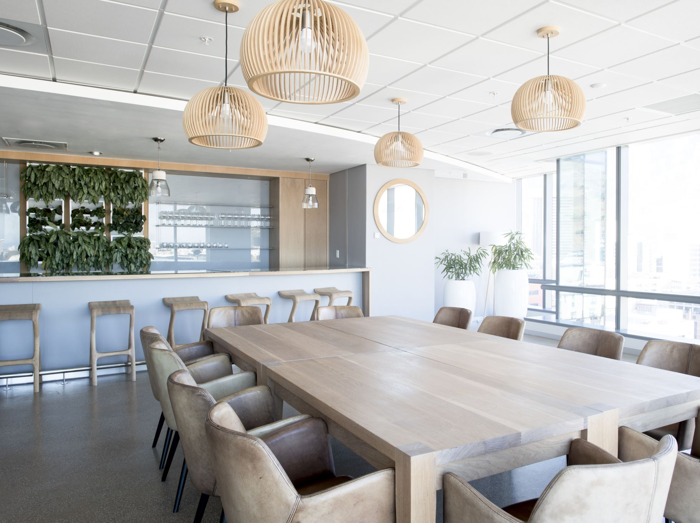
Thank You

